Slide 1



CONTACT SEARCH APPLICATION
Sk.Fakruddin (22501A05G1)
V.Vignesh (22501A05J1)
Y.Eswar Aditya (22501A05J8)
Sd.Md.Afzal (22501A05J8)

Slide 2
TABLE OF CONTENT
01.
05.
USER FLOW DIAGRAM
DISPLAY CONTACTS
02.
06.
INSERTION OF CONTACT
SEARCH CONTACT
03.
07.
DELETION OF CONTACT
FUZZY SEARCH CONTACT
04.
08.
EXPORT CONTACT TO VCF
MODIFY CONTACT

Slide 3
USER FLOW DIAGRAM

Slide 4
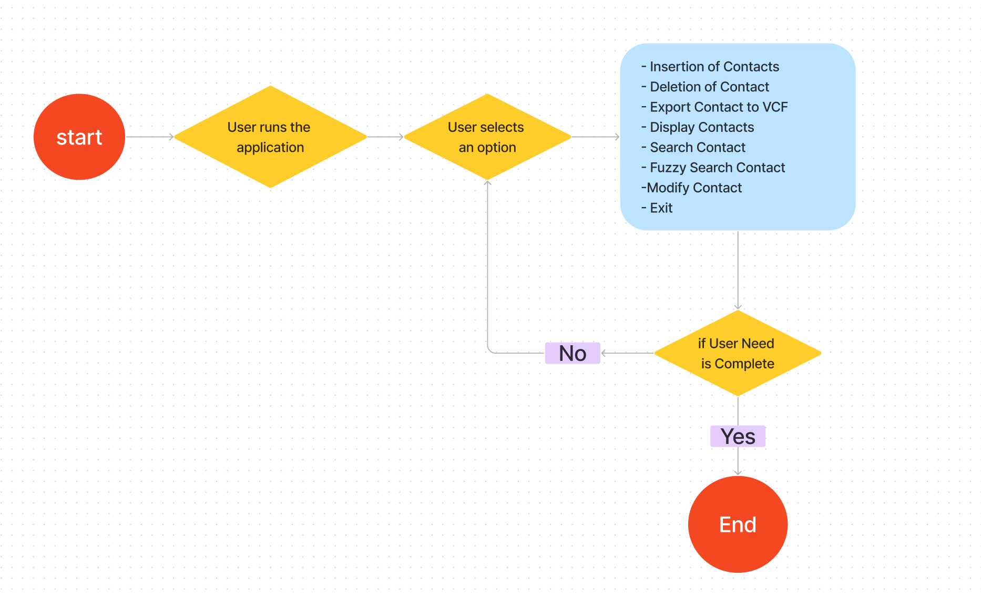

Slide 5
INSERTION OF CONTACT

Slide 6
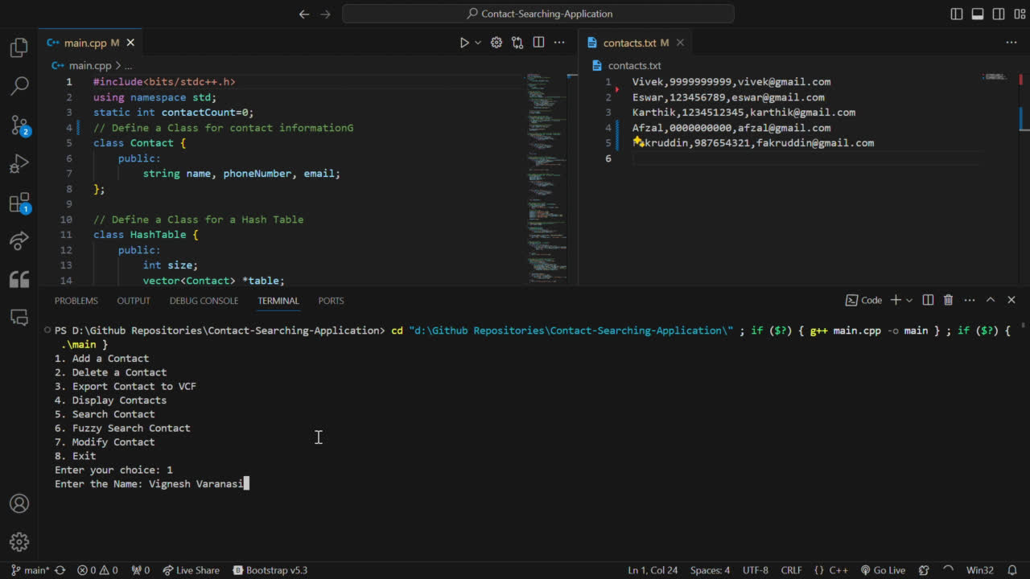

Slide 7
DELETION OF CONTACT

Slide 8
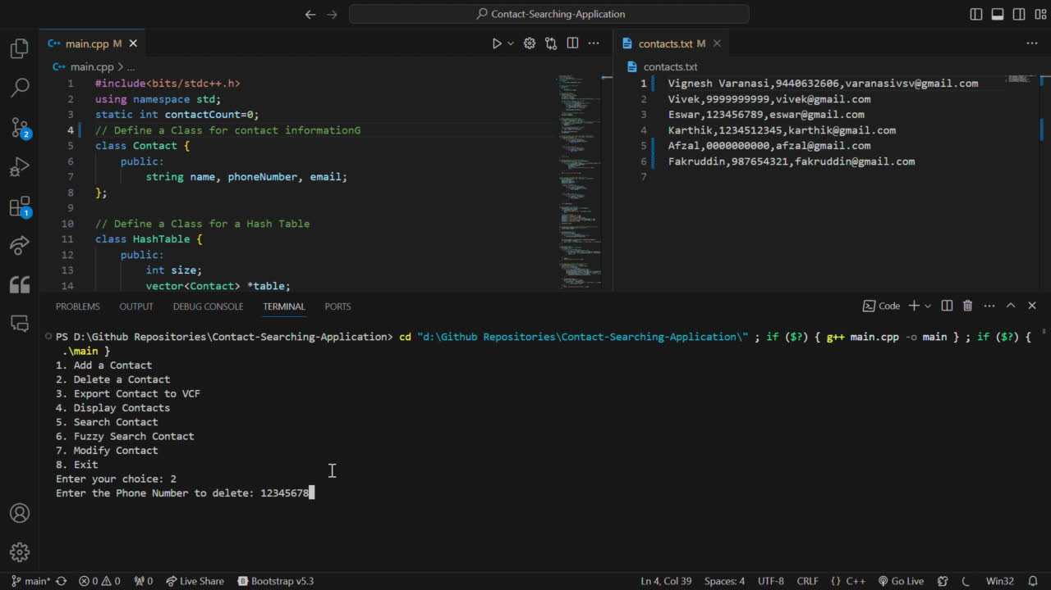

Slide 9
EXPORT CONTACT TO VCF

Slide 10
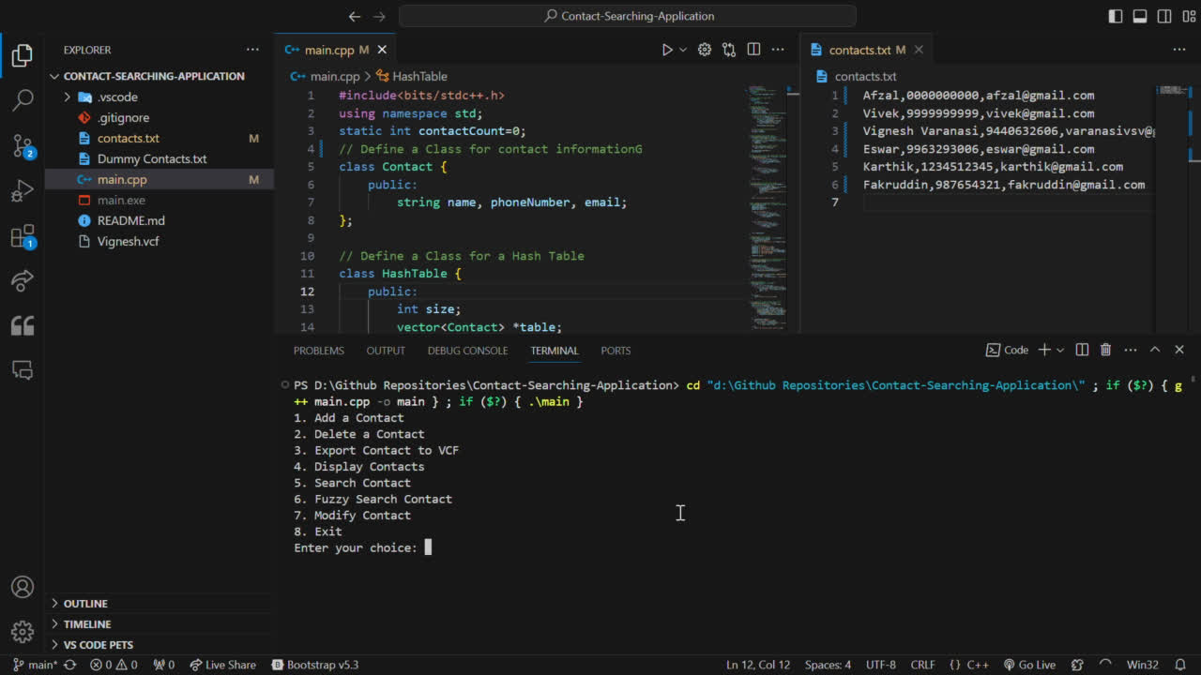

Slide 11
DISPLAY CONTACTS

Slide 12
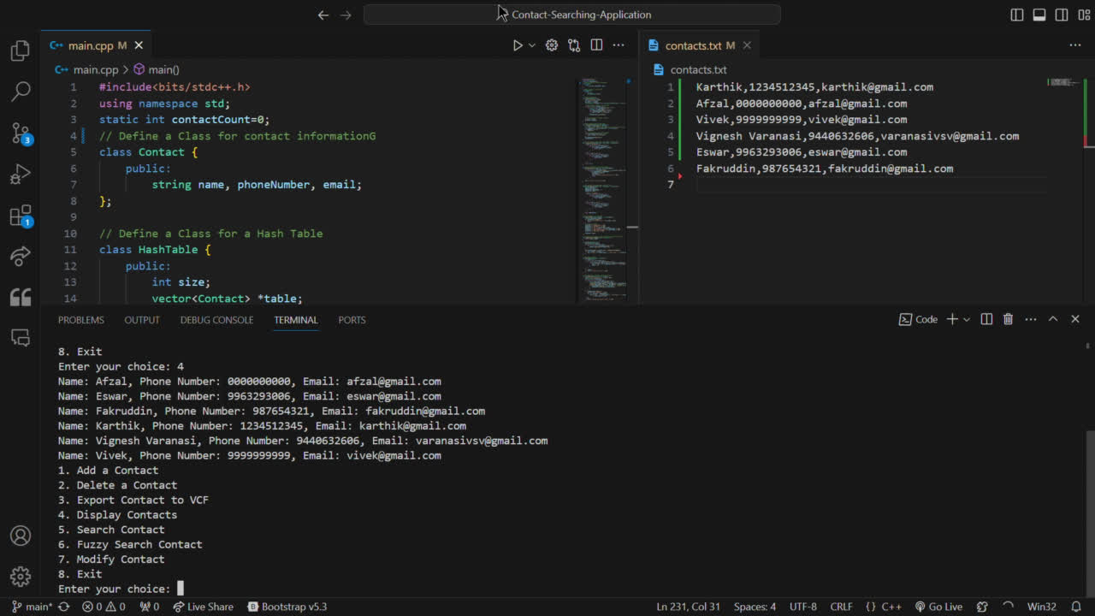

Slide 13
SEARCH CONTACT

Slide 14
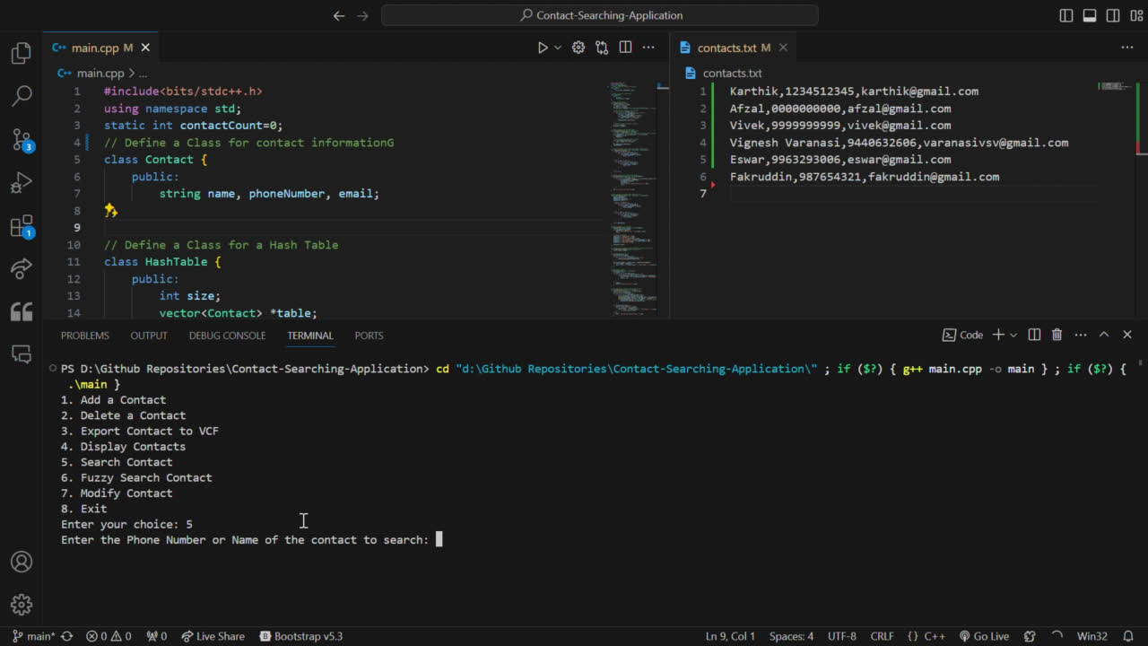

Slide 15
FUZZY SEARCH CONTACT

Slide 16
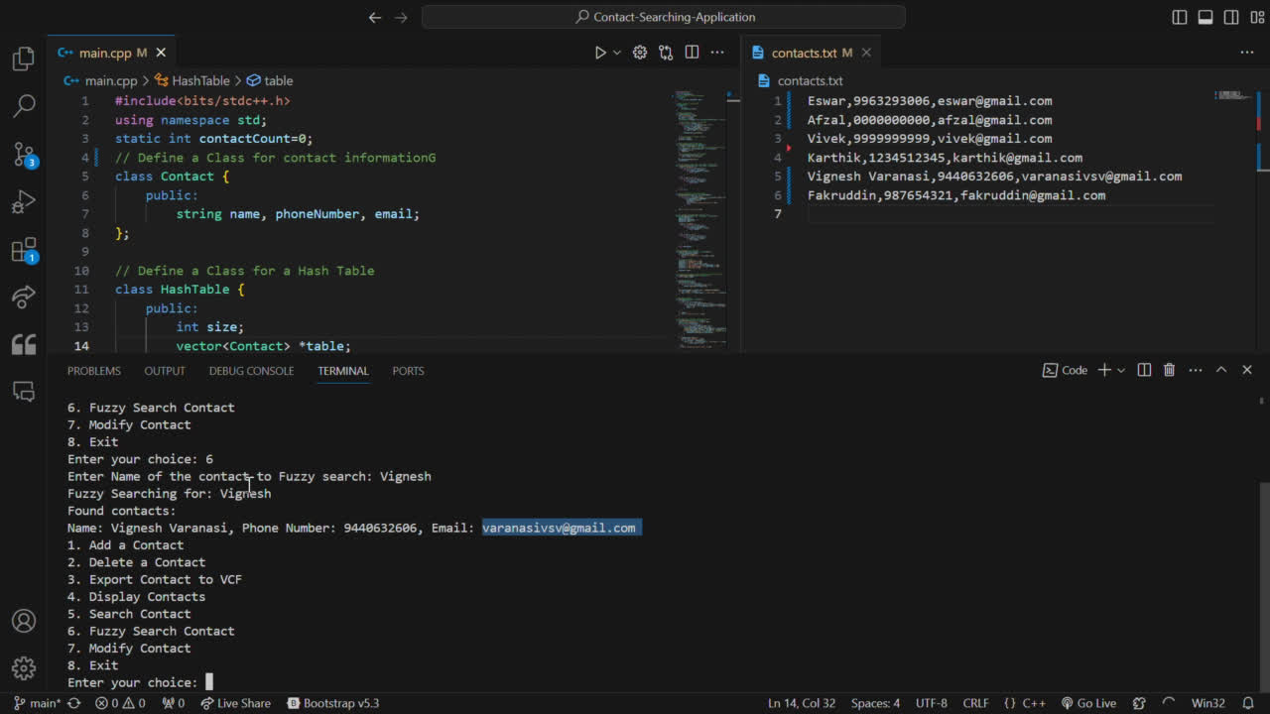

Slide 17
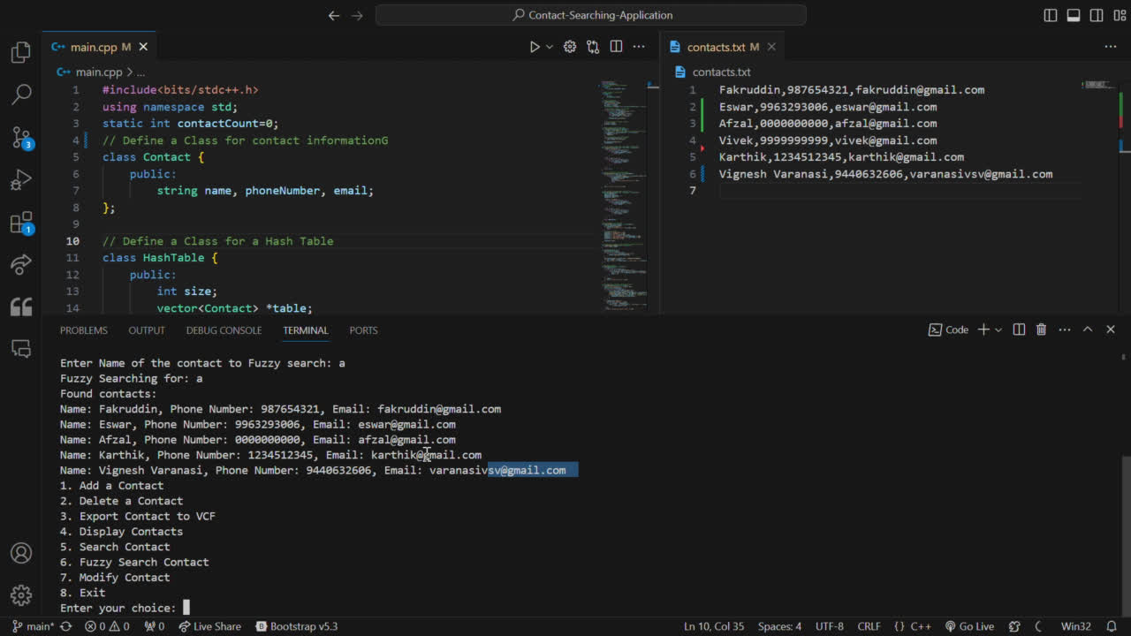

Slide 18
MODIFY CONTACT

Slide 19
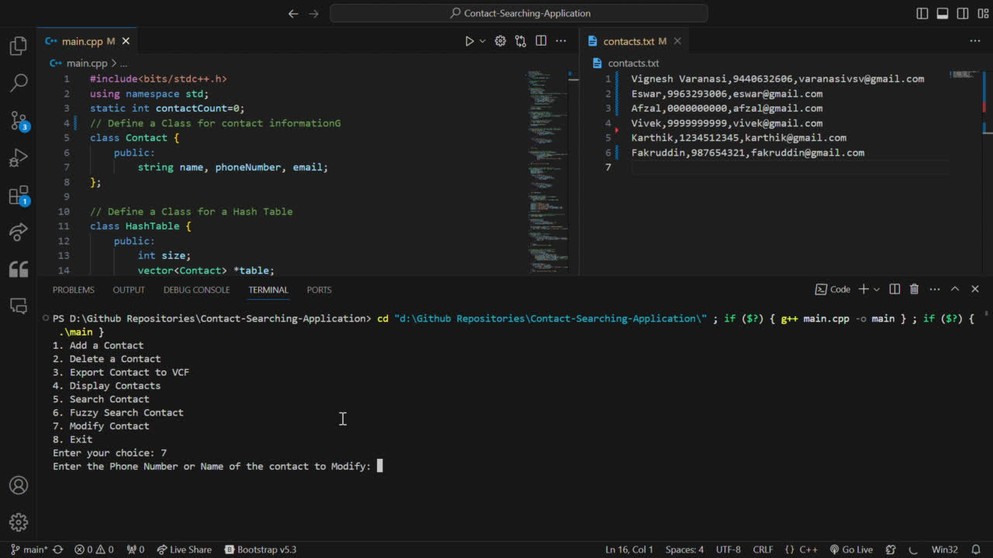

Slide 20
Have any question?

Slide 21
THANK YOU

